Slide 1


How to really use Google Gemini 1.5

Slide 2

Data Analysis
Notes:
Get the penguin dataset and do a full data analysis of the data with all visuals possible.
Look at this data and do a full data analysis with all data possible.

Slide 3
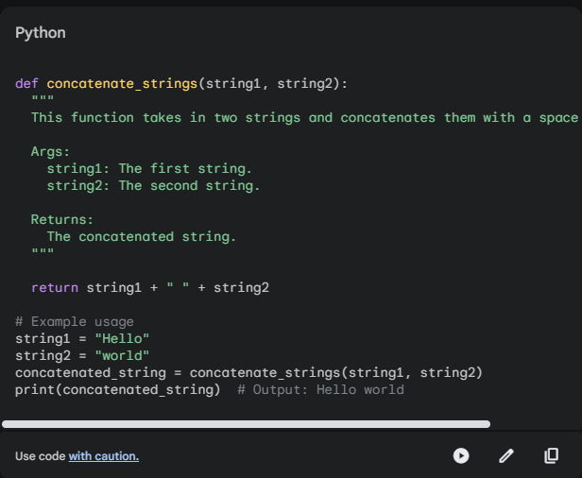
Python in Gemini
Notes:
Create a function that glues two pieces of text together with a space between them.

Slide 4
packages
IPython, PIL, __future__, __hello__, __main__, _aix_support, _bootsubprocess, _collections_abc, _compat_pickle, _compression, _markupbase, _osx_support, _py_abc, _pydecimal, _pyio, _sitebuiltins, _strptime, _sysconfigdata__darwin_x86_64-darwin, _sysconfigdata__linux_aarch64-linux-gnu, _sysconfigdata__linux_x86_64-linux-gnu, _threading_local, _weakrefset, abc, absl, aifc, altair, antigravity, apipkg, appdirs, argparse, ast, async_sandbox_rpc, asynchat, asyncio, asyncore, attr, attrs, base64, bdb, bisect, blaze_compatibility_hack, bz2, cProfile, calendar, cgi, cgitb, charts_json_writer, chess, chunk, cmd, code, codecs, codeop, collections, colorsys, compileall, concurrent, configparser, contextlib, contextvars, contourpy, copy, copyreg, crypt, cssselect, csv, ctypes, curses, cv2, cycler, dataclasses, datetime, dateutil, dbm, decimal, decorator, defusedxml, difflib, dis, distutils, doctest, email, encodings, entrypoints, enum, et_xmlfile, filecmp, fileinput, fnmatch, fontTools, format_exception, fractions, fs, ftplib, functools, future, genericpath, getopt, getpass, gettext, glob, gmpy2, google, google3, graphlib, gzip, hashlib, heapq, hmac, html, http, husl, imaplib, imghdr, imp, importlib, iniconfig, inspect, io, ipaddress, jaraco, jinja2, joblib, json, jsonschema, keyword, kiwisolver, lib2to3, libfuturize, libpasteurize, linecache, locale, logging, lxml, lzma, mailbox, mailcap, markupsafe, matplotlib, matplotlib_post_processor, mimetypes, modulefinder, more_itertools, mpl_toolkits, mpmath, multiprocessing, netrc, nntplib, ntpath, nturl2path, numbers, numexpr, numpy, opcode, openpyxl, operator, optparse, os, packaging, pandas, past, pathlib, patsy, pdb, pexpect, pickle, pickletools, pipes, pkg_resources, pkgutil, platform, platformdirs, plistlib, poplib, posixpath, pprint, profile, pstats, psutil, pty, ptyprocess, py, py_compile, py_interpreter, py_interpreter_blaze, pyclbr, pydoc, pydoc_data, pydot, pyglet, pyparsing, pyrsistent, pytz, queue, quopri, random, re, reprlib, rlcompleter, runpy, sandbox_rpc, sandbox_rpc_pb2, sched, scipy, seaborn, secrets, selectors, shelve, shlex, shutil, signal, site, six, sklearn, smtpd, smtplib, sndhdr, socket, socketserver, sqlite3, sre_compile, sre_constants, sre_parse, ssl, stat, statistics, statsmodels, string, stringprep, striprtf, struct, subprocess, sunau, sympy, symtable, sysconfig, tables, tabnanny, tarfile, telnetlib, tempfile, textwrap, theano, this, threading, threadpoolctl, timeit, tkinter, token, tokenize, tomllib, toolz, tornado, trace, traceback, tracemalloc, tty, turtle, types, typing, uharfbuzz, unittest, urllib, uu, uuid, vega_datasets, venv, warnings, wave, weakref, webbrowser, wsgiref, xdrlib, xlrd, xml, xmlrpc, zipapp, zipfile, zipimport, zmq, zoneinfo
Notes:
List all the python packages currently installed.

Slide 5

Extensions
Notes:
https://gemini.google.com/extensions
@Google Drive summarize all the AI articles

Slide 6


